Slide 1
TOUR GUIDE PROVIDING SERVICE
Tanmoy Mazumder- 19101013
Ali Mostakim Alvi- 19101015
Shawan Das- 19101020

Slide 2
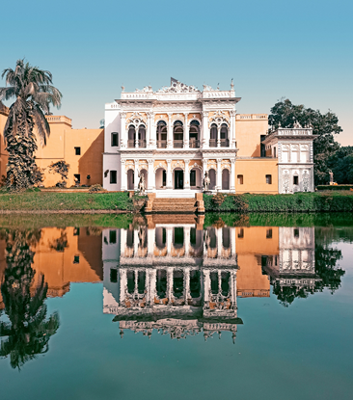
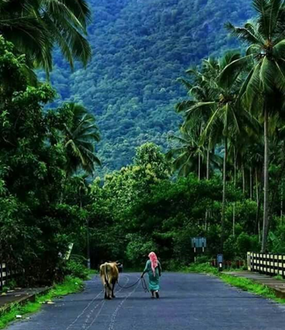
OBJECTIVE
Providing easy access to local tour guides
Turn the guiding sector more reliable
Creation of a new part time job sector

Slide 3
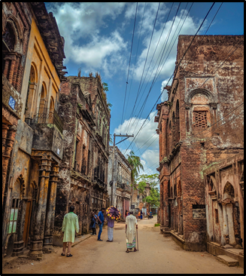
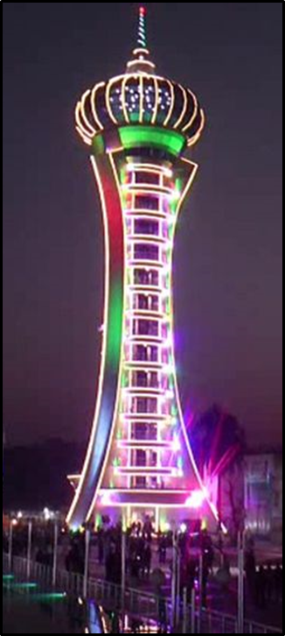

INTRODUCTION
A new web based addition to the expansion of the tourism sector in Bangladesh.
Making it easy for local people to engage in a part time guiding job.
Resulting in an abundance of guides that are ready to help the tourists.

Slide 4
SIMILAR EXISTING SYSTEMS
Name | Remarks
Bangladesh tourism guide | Badly maintained
Private guides | Badly maintained
Tour by locals | Not much famous among Bangladeshis

Slide 5
NOVELTY OF THIS PROJECT
Focused on polished user experience
Review blog
Ease of payment
Quick access to local law enforcement

Slide 6
Implementation plan and Required elements
Web tools i.e. html, css, bootstrap, javascript, Django
Manpower
Initial investment

Slide 7
System Development Life cycle
Planning
Maintanance
Analysis
Implementation
Design

Slide 8
Planning
Identify Problem.
identify opportunity
Identify Objective
Examine Analysts
Make UI understandable
Manage users

Slide 9
Feasibility Study:
Economic feasibility
Technical feasibility
Operational feasibility
Schedule feasibility
Legal feasibility

Slide 10
Analysis
Data Flow Diagram
Data Dictionary
Semi-structure decision
Prepare & present system proposal
Recommend optimal solution

Slide 11
Design
Design Interface
Design System Control
Design file or Database
Program Specification
Produce decission tree table

Slide 12
Implementation
Design security measures
Plan Conversion
Train users
Purchase and install new equipment.
Convert files & Install system
Review & evaluate system.

Slide 13
Maintenance
Test & debug computer programs
Test computer system
Develop system

Slide 14
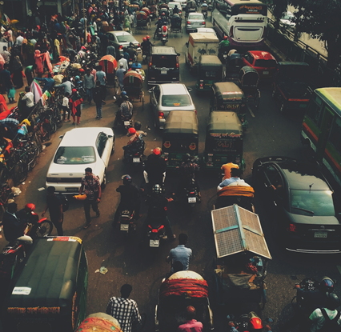
THANK YOU

